Slide 1


Closing the Gap
Improving outcomes for Aboriginal and Torres Strait Islander people
Notes:
BACKGROUND
The Government’s Closing the Gap agenda is part of the broader Indigenous reform agenda captured in the National Indigenous Reform Agreement (NIRA) that was agreed to by Council of Australian Governments (COAG) in 2008.
The Closing the Gap approach is built on three elements:
Systemic reforms in all sectors. Mainstream systems will be required to make a disproportionate effort and investment in outcomes for Indigenous Australians.
Supplementing mainstream investment with Indigenous-specific initiatives that emphasise innovation, engagement and improving service quality.
Overlaying mainstream reform with Indigenous-specific strategies that focus and integrate mainstream and supplementary effort.
These three elements are mutually reinforcing and will combine into a coherent and comprehensive approach.

Slide 2

I see closing the gap as a genuinely important national goal… that all Australians will have the same opportunities
The Prime Minister of Australia, the Hon Julia Gillard MP, 9 February 2011
Notes:
SPEAKING NOTES
In her Report to Parliament on Closing the Gap on 9 February 2011, the Prime Minister, Julia Gillard MP, reiterated the Australian Government’s commitment to Closing the Gap in life expectancy and life opportunities between Indigenous and non-Indigenous Australians.

Slide 3
The disadvantage experienced by Aboriginal and Torres
Strait Islander people is profound and long standing
Twice as many Indigenous children will die before the age of 5
8 times more Indigenous children are likely to be under care and protection orders
13 times more Indigenous people are likely to be in prison
An Indigenous man can expect to live to 63, an Indigenous woman to 73 whereas a non-Indigenous man lives to 88 and a non-Indigenous woman to 89
30%–50% of the life expectancy gap is due to factors other than health, especially education and employment
A person’s wellbeing and quality of life are directly related to DEEWR’s work
Disadvantage accumulates. The longer or more frequently a person experiences ill-health or poor social and economic circumstances, the lower their quality of life overall and life expectancy
Notes:
SPEAKING NOTES
The facts are indisputable. Improvements in social and economic indicators for Indigenous Australians will improve their opportunities and wellbeing over the course of their lives.
We need to apply the lessons learned in our delivery of programs and initiatives to Indigenous Australians.
We also have the opportunity to contribute to the evidence on what works in improving outcomes for Indigenous Australians.
In looking at issues from the perspective of Indigenous Australians, we can add value to our research, analyses and evaluations of our programs, initiatives and policy frameworks.
BACKGROUND
There are key resources which demonstrate how improvements in social and economic indicators for Indigenous Australians improve opportunities over the life course :
Australian Institute of Health and Welfare and Australian Institute of Family Studies: Closing the Gap Clearinghouse
Steering Committee for the Review of Government Service Provision: Overcoming Indigenous Disadvantage
Australian Institute of Health and Welfare: Aboriginal and Torres Strait Islander Health Performance Framework
Australian Bureau of Statistics: The Health and Welfare of Australia’s Aboriginal and Torres Strait Islander Peoples

Slide 4
The Indigenous population is relatively young and geographically dispersed
The median age for Indigenous Australians is 21 years compared to 37 years for non-Indigenous Australians
4 in 10 Indigenous Australians are aged less than 15 years compared with 2 in 10 non-Indigenous Australians
5 in 10 dependent children living in Indigenous families, live in one parent families compared with
2 in 10 dependent children living in non-Indigenous families
6 in 10 Indigenous Australian adults identify with a clan, tribal or language group
1 in 9 Indigenous Australian adults speak an Aboriginal and Torres Strait Islander language as their main language at home
Three-quarters of Indigenous Australians live in major cities or regional areas of Australia, compared to almost all of non-Indigenous Australians
32% of Indigenous Australians live in major cities (vs 69% of non-Indigenous), 43% live in regional areas (vs 29% of non-Indigenous), and 25% live in remote areas (vs 2% of non-Indigenous)
The Indigenous population is likely to become more urbanised. The greatest increase in the Indigenous population to 2021 is expected in major cities (up 50%) and regional areas (up 46%), with limited growth in remote Australia (up 14%).
Notes:
SPEAKING NOTES
Having an understanding of Australia’s Indigenous population is the first step in ensuring that our Closing the Gap efforts are well directed.
In 2006, there were 517,000 people who were of Aboriginal and Torres Strait Islander origin. Aboriginal and Torres Strait Islander Australians comprise 2.5 per cent of Australia’s population.
The Indigenous population is relatively younger than the non-Indigenous population. In 2006 almost 40 per cent of Indigenous Australians were aged less than 15 years, compared with 20 per cent of non-Indigenous Australians.
This younger age profile contributes to the low median age of 21 years relative to 37 years for
non-Indigenous Australians.
Indigenous families also have a different composition. For example, we know that a larger proportion of dependent children in Indigenous families, live in one parent families compared with dependent children in non-Indigenous families.
Cultural attachment remains important to Aboriginal and Torres Strait Islander peoples, with significant proportions who speak an Aboriginal or Torres Strait Islander language as their main language at home, and identifying with clan, tribe or language groups.
Most Indigenous Australians live in major cities and regional areas of Australia, at around 75 per cent of the Indigenous population. However, a greater proportion of Indigenous Australians live in remote areas compared with the non-Indigenous population.
Current population projections indicate that the Indigenous population is likely to become more urbanised, with the greatest growth likely to be in urban and regional areas.

Slide 5
DEEWR is making a positive difference to the lives of Aboriginal and Torres Strait Islander people
In 2008, the Australian Government made a historic commitment to close the gap in life expectancy and life opportunities between Indigenous and non-Indigenous Australians
Six targets to close the gap in Indigenous disadvantage were agreed by the Council of Australian Governments and these form the pillars of the Government’s national Indigenous reform agenda
DEEWR has lead responsibility for four targets related to early childhood, education and employment:
Ensure all Indigenous four year olds in remote communities have access to quality early childhood education by 2013
Halve the gap for Indigenous students in reading, writing and numeracy by 2018
Halve the gap for Indigenous 20–24 year olds in Year 12 or equivalent attainment rates by 2020
Halve the gap in employment outcomes between Indigenous and non‑Indigenous Australians by 2018
Indigenous business is everyone’s business. This means that all our programs, services and policies need to improve outcomes for Aboriginal and Torres Strait Islander people
We need to work together to ensure that mainstream and targeted initiatives across all clusters reinforce each other and produce positive outcomes for all Indigenous Australians
Notes:
SPEAKING NOTES
The Council of Australian Governments has prioritised Closing the Gap in Indigenous Disadvantage as one of its five themes of strategic importance.
The framework for Closing the Gap in Indigenous disadvantage is captured in the National Indigenous Reform Agreement. There is no funding attached to the agreement to achieve the Closing the Gap targets.
Indigenous specific and mainstream National Agreements and National Partnership Agreements help deliver targeted actions to close the gap in Indigenous disadvantage.
Existing Commonwealth, State and Territory mainstream and Indigenous specific programs, initiatives and policies will need to contribute to achieving the targets as well.
For DEEWR, this means collaborating across clusters and with other Commonwealth, State and Territory agencies to improve outcomes for Indigenous Australians.
We are a lead agency in achieving the Closing the Gap targets. A significant amount of our efforts will contribute to meeting the Closing the Gap targets in health :
Close the life expectancy gap by 2031.
Halve the gap in mortality rates for Indigenous children under five by 2018.
BACKGROUND
The National Indigenous Reform Agreement outlines the holistic approach required to achieve the targets:
Indigenous-specific National Partnership Agreements.
Improvements in outcomes are required for Indigenous Australians across urban, regional and remote Australia.
Principles for the design and delivery of mainstream and Indigenous specific government programs and services provided to Indigenous Australians.
Present priorities to improve census, administrative and survey data collections.
Indicative trajectories of improvement needed to achieve the targets.

Slide 6
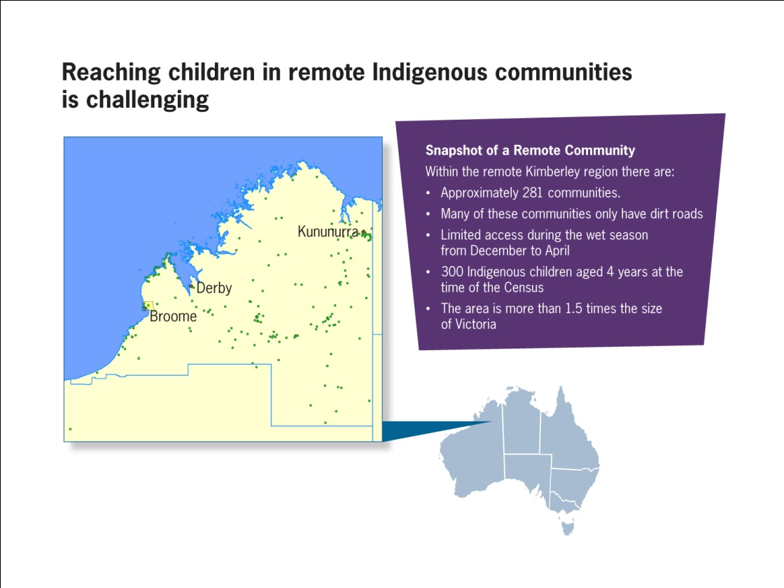
Experiences during early childhood affect outcomes in education, employment and health later in life
Ensure all Indigenous four year olds in remote communities have access to quality early childhood education by 2013
Why is this target important?
Early childhood is a critical stage in human development—children’s experiences can harm or benefit their later health, learning and behaviour
Indigenous children are almost 4 times more likely to be developmentally vulnerable in literacy and numeracy in their first year of full-time schooling
Ensuring all children have access to high quality early childhood education gives them the best start in life, and sets them on the path to success in school, further education and work
What is the gap and how are we going?
Available data suggest that 87 per cent of Indigenous children in remote locations are enrolled in preschool, compared to 70 per cent nationally
We have made significant progress in ensuring access to early childhood education, and are likely to meet this target in 2013
Notes:
SPEAKING NOTES
We are likely to achieve the Early Childhood target, but cannot be complacent about the obstacles in front of us.
As preschool attendance is voluntary, a 95 per cent enrolment rate has been agreed as the target.
Based on National Preschool Census (NPC) data, the Indigenous preschool enrolment rate for children in the year prior to full-time schooling in remote locations was 87 per cent in 2009.
If the indicative figures are assumed to be accurate, the data suggest that around 378 Indigenous children in the year before full-time schooling in remote communities across Australia were not enrolled in preschool in 2009; 2570 enrolled out of a possible 2948.
The 2009 Overcoming Indigenous Disadvantage Report identified key issues for early childhood development:
Influences during the early years affect learning, behaviour and health outcomes over the life course.
Good quality early childhood education programs provide children with a head start at school.
There are higher rates of school completion, literacy and numeracy achievement and better social skills where children attend good quality early childhood education programs.
Investing in the development of children at an early age is more effective than dealing with issues down the track.
BACKGROUND
The Australian Early Development Index (AEDI) National Report 2009 provides a snapshot of young children’s health and development.
In 2009, the AEDI collected information on 261,203 Australians in their first year of full-time school between 1 May and 1 July.
The Report shows how children have developed by the time they start school, across five areas of early childhood development :
Physical health and wellbeing
Social competence
Emotional maturity
Language and cognitive skills (school-based)
Communication skills and general knowledge
The majority of Australian Indigenous children are developmentally on track on all the AEDI domains, with the exception of the language and cognitive skills (school-based) domain.
However, there are higher proportions of Australian Indigenous children developmentally vulnerable on each of the AEDI domains compared to non-Indigenous children.
47.3 per cent of Indigenous children are developmentally vulnerable on one or more of the AEDI domains.
29.5 per cent of Indigenous children are developmentally vulnerable on two or more of the AEDI domains.

Slide 7
Indigenous Australian children will have quality early childhood education for the best start in life
What are we doing?
Building a quality workforce and developing quality standards for early childhood education and care including through the implementation of the Early Years Learning Framework
Ensuring all children have access to early childhood education in the year before formal schooling under the National Partnership Agreement on Early Childhood Education
Funding 38 Children and Family Centres to bring together important services including child care, early learning, and parent and family support programs as part of the National Partnership Agreement on Indigenous Early Childhood Development
Notes:
SPEAKING NOTES
Indigenous specific and mainstream early childhood reforms are contributing to the outcomes needed to achieve the target.
The Early Childhood Education National Partnership provides funding for infrastructure, staffing and program delivery.
These initiatives help to improve participation and inclusion of Indigenous children in early learning.
The Government provides around $54 million annually to directly fund around 340 early childhood services under the Budget Based Funded (BBF) Program.
These services are funded to address the failure of the market to deliver mainstream child care, for example, in regional and remote areas and the need for culturally competent services.
Of these services, 260 or about 77 per cent are Indigenous focussed services and
63 per cent are in remote locations.
The Government is providing around $3 million over four years (July 2009) for 29 Indigenous Remote Service Traineeships to provide structured, supported and sustainable pathways to work for Aboriginal and Torres Strait Islander people in remote BBF services.
Eight Indigenous trainees have commenced to date.
Through the National Partnership Agreement on Indigenous Early Childhood Development, the Government is providing funding for the establishment of 38 Children and Family Centres that will deliver integrated services, including early learning, child care and family support programs to Indigenous families.
16 of the 38 centres are to be located in remote areas. 9 are in Remote Services Delivery priority communities.

Slide 8
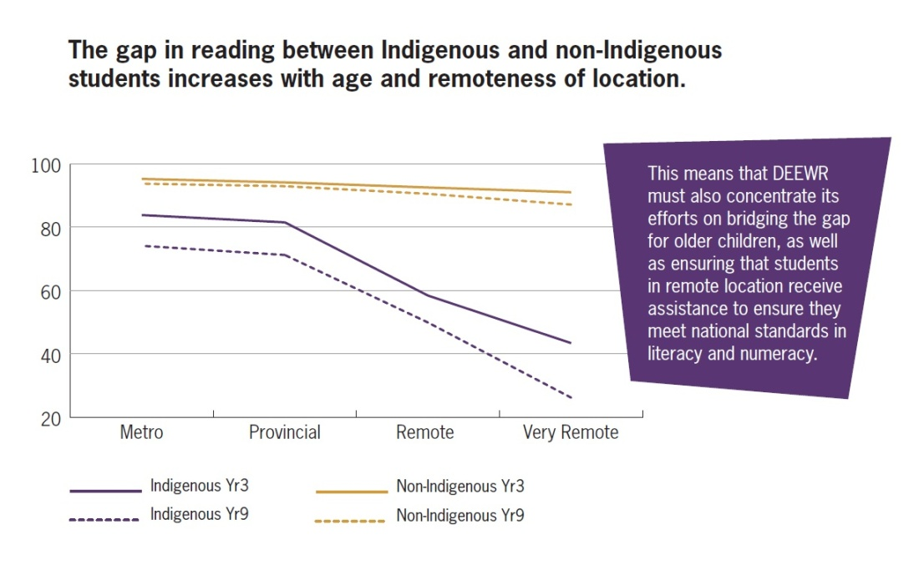
Gaps in literacy and numeracy skills increase with age and location
Halve the gap for Indigenous students in reading, writing and numeracy by 2018
Why is this target important?
Achieving literacy and numeracy benchmarks in Years 5 and 7 promotes greater participation in Year 12 and entry into higher education
Indigenous students are 5 times more likely to achieve below the national minimum standards in Year 9 reading in very remote areas compared with non-Indigenous students
School leavers who have sound skills in literacy and numeracy have much better employment prospects
What is the gap and how are we going?
The size of the gap differs across domains and across year levels, ranging from a low of 17.6 percentage points (Year 3 Writing) to the largest gap 29.7 percentage points (Year 9 writing) in 2010
Small improvements were made between 2008-2010 and seven of the twelve national literacy and numeracy targets were met in 2010
Notes:
SPEAKING NOTES
There are 12 separate goals for Years 3, 5, 7 and 9 in reading, writing and numeracy which are measured through the National Assessment Program – Literacy and Numeracy.
There are early signs of progress. Between 2008 and 2010 the gap narrowed for:
Years 3, 5 and 7 Reading
Years 5 and 7 Writing
Year 5 Numeracy
The gap in reading, writing and numeracy is influenced by a range of factors including teacher quality, parental engagement and school attendance.
The 2009 Overcoming Indigenous Disadvantage Report identified the following key messages for achievements in literacy and numeracy:
The difference in cognitive test scores between Indigenous and non-Indigenous children widens over the life course.
Children who do not receive assistance through preschool and primary school are rarely able to catch up.
Indigenous students miss around 26 days of school each year compared with
8 days for non-Indigenous students. Indigenous students in remote areas are likely to miss a greater number of days.
The gap in literacy and numeracy widens with remoteness of location. The challenge in closing this gap is balancing the higher need of children in remote communities and the greater population in urban and regional areas.
BACKGROUND
National Assessment Program – Literacy and Numeracy (NAPLAN) data show relatively lower levels of participation in the assessments for Indigenous students compared with all students.
In 2008, participation rates for Year 9 Indigenous students in NAPLAN testing were around 80 per cent compared with over 90 per cent for all students.
The lower rates of participation from Indigenous students, from absences or withdrawal from testing, especially in remote areas, has the potential to overestimate the actual level of literacy and numeracy achievement.
Literacy and numeracy achievements are not calculated for students who are absent or withdrawn from testing.

Slide 9
Indigenous students with good literacy and numeracy skills are more likely to finish Year 12
What are we doing?
Improving literacy and numeracy standards, producing high-quality teachers, and supporting disadvantaged students under the Smarter Schools National Partnerships
Investing in school infrastructure, Trade Training Centres and the Digital Education Revolution to improve the quality of every student’s education
Providing transparency in school performance data through MySchool, and the development of world-class national curriculum
$56.4 million over four years from 2008–09 to expand intensive literacy and numeracy programs and provide for personalised learning plans to assist Indigenous students who are not achieving at the level of the rest of their class
Notes:
SPEAKING NOTES
There are significant downstream disadvantages associated with low rates of literacy and numeracy:
Low achievement in literacy and numeracy in the early years affects participation rates in secondary and tertiary education.
People with below minimum standards in literacy and numeracy have lower rates of participation in employment.
Low literacy levels presents barriers to improving health outcomes for Indigenous Australians.
One of the initiatives DEEWR is working with States and Territories to implement is the Aboriginal and Torres Strait Islander Education Action Plan.
The Action Plan reinforces the targeted activities of mainstream National Partnership Agreements with its priority areas for action.
The priority areas in the Aboriginal and Torres Strait Islander Education Action Plan are :
School readiness
Engagement and connections
School attendance
Literacy and numeracy
Leadership
Quality teaching and workforce development
Pathways to post-school options
Implementation of the Action Plan with its focus on these priorities will help improve education outcomes for Indigenous Australians and their social circumstances later in life.

Slide 10
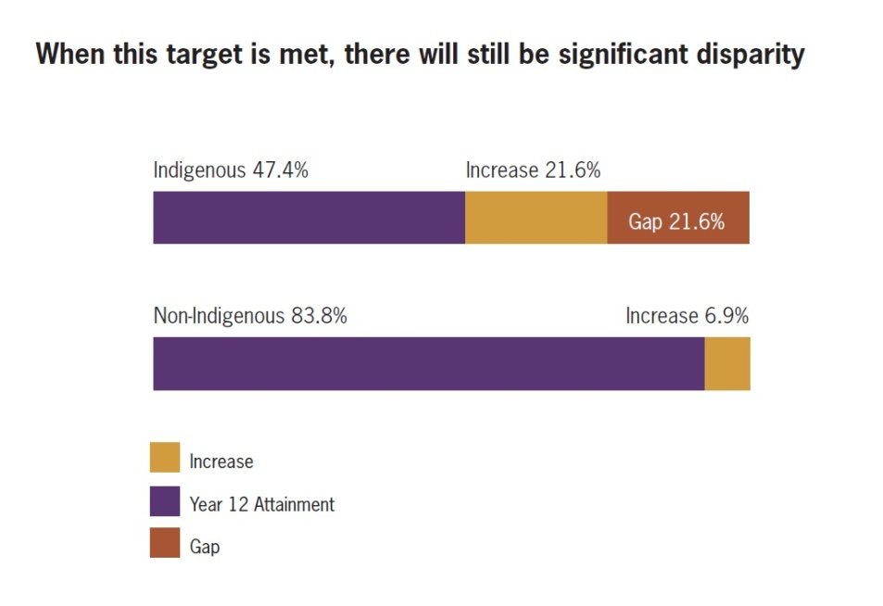
A Year 12 or equivalent qualification is vital for today’s labour market
Halve the gap for Indigenous 20-24 year olds in Year 12 or equivalent attainment rates by 2020
Why is this target important?
  Finishing Year 12 gives young people better choices and access to further education, training, employment and opportunities in life
  People who have attained Year 12 are more likely to be employed and have a higher income
  Finishing school can reduce the need for remedial education and social welfare services
  Staying at school reduces the likelihood of young people being involved in crime
What is the gap and how are we going?
  There was a good trend of increasing rates of attainment from 2001 to 2006
  17,000 more 20-24 year old Indigenous Australians must have a Year 12 or equivalent qualification by 2020 over and above the current rates
  In 2008, if you were a working age Indigenous Australian with Year 12 or equivalent qualification, you were almost twice as likely to be employed than those without these qualifications
Notes:
SPEAKING NOTES
To achieve the Year 12 attainment target, 69 per cent of Indigenous 20–24 year olds will need to obtain Year 12 or an equivalent qualification (at or above Certificate II) by 2020.
If there was no improvement in Indigenous attainment rates, we estimate the gap would increase from 36.4 percentage points in 2006 to 43.3 percentage points in 2020.
Halving the gap by 2020, would still mean a gap of 21.6 percentage points in attainment rates between Indigenous and non-Indigenous young people.
Based on current trends, achieving the 2020 target will require around 17,000 additional 20–24 year old Indigenous Australians to attain Year 12 or equivalent.
Employment outcomes are better for workforce age Indigenous Australians who have Year 12 or equivalent attainment:
The proportion of the Indigenous population in employment is higher for those persons with Year 12 or equivalent (72.3 per cent versus 41.9 per cent).
The Indigenous unemployment rate is lower for those persons with Year 12 or equivalent (11 per cent versus 22.1 per cent).
The Indigenous labour force participation rate is higher for those persons with Year 12 or equivalent (81.3 per cent versus 53.8 per cent).
DESCRIPTION OF CHART
The chart on screen shows the changes in the proportion of Indigenous young people with Year 12 or equivalent attainment needed to achieve the target.
In 2006, there were 47.4 per cent of Indigenous young people with Year 12 or equivalent attainment.
We estimate that in 2020 there will be 90.7 per cent of non-Indigenous young people with this level of educational achievement. This will represent an increase of 6.9 percentage points on 2006 achievements (83.8 per cent).
If there is no improvement in Year 12 or equivalent attainment rates for Indigenous young people, the gap will increase from 36.4 percentage points in 2006, to 43.3 percentage points in 2020.
To halve this gap, the proportion of Indigenous young people with Year 12 or equivalent attainment will need to increase by 21.6 percentage points (half of 43.3 percentage points) to 69.0 percent. This means that in 2020, an estimated 32,000 Indigenous young people will need to have Year 12 or equivalent attainment, more than double the number with that accomplishment in 2006.
Although reaching the target will be a substantial achievement, there will still be great disparity in educational outcomes for Indigenous young people.

Slide 11
Young people at risk of not finishing school need tailored support
What are we doing?
  Linking young people with Youth Connections and School Business Community
  Partnership Brokers to support them to go back to school or get a job
  Promoting personalised learning for Indigenous students through to Year 10 under the Aboriginal and Torres Strait Islander Education Action Plan
  $4.1 million over three years in the 2011–12 Budget to provide the opportunity for Indigenous students to develop the skills and knowledge to become a ranger through the Indigenous Ranger Cadetships program
  Strengthening education outcomes through initiatives such as Parent and Community Engagement, Sporting Chance and Indigenous Youth Leadership programs
Notes:
SPEAKING NOTES
Improving Year 12 and equivalent attainment rates is especially challenging in remote and regional Australia.
Australian Bureau of Statistics, 2008 National Aboriginal and Torres Strait Islander Social Survey data show that Year 12 and equivalent attainment rates for Indigenous 20-24 year olds were:
27.6 per cent in remote Australia
48.9 per cent in regional Australia
55.8 per cent in Australia’s major cities
DEEWR’s programs such as Youth Connections help young people to stay at school, return to school or take up training to achieve Year 12 or equivalent.
In 2010, more than 3,500 Indigenous young people at risk of leaving school were assisted under the program.

Slide 12
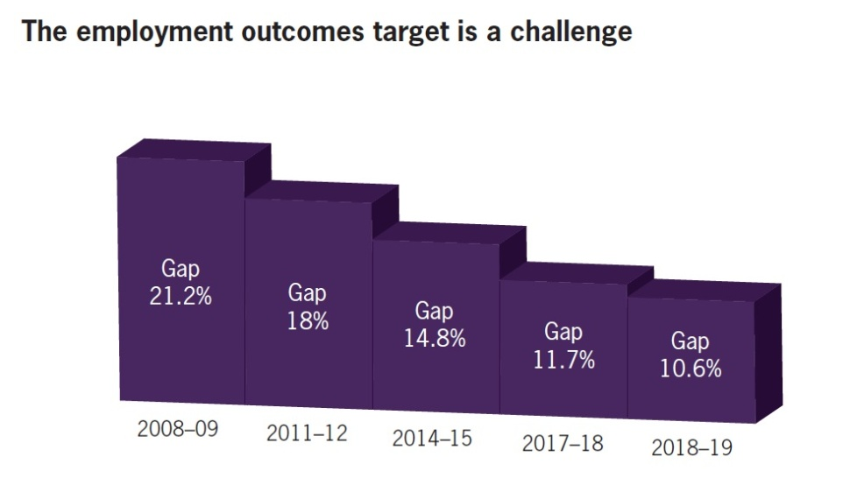
Employment is the key to economic independence for Aboriginal and Torres Strait Islander people
Halve the gap in employment outcomes between Indigenous and non‑Indigenous Australians by 2018
Why is this target important?
  Having a job provides families with a better standard of living and better health in the long run, especially for children
  Secure employment is vital to breaking the cycle of poverty and welfare dependency
  Economic participation improves the choices open to people and improves the national economy
What is the gap and how are we going?
  There have been small improvements from 2002-2008 with employment rising by 5.6 percentage points, labour force participation rising by 1.9 percentage points, and unemployment falling by 6.4 percentage points
  100,000 additional Indigenous Australians must have a job by 2018
  This target is not just about unemployment—participation in the labour force must increase
  In 2004-05 almost 50% of 15-64 year old Indigenous Australians relied primarily on income support, for non-Indigenous Australians this figure was less than 20%
Notes:
SPEAKING NOTES
The employment outcomes target is definitely a challenge for us.
Achieving this target is difficult because increasing the proportion of workforce-age Indigenous Australians in employment from 53.8 per cent to 66.8 per cent, requires:
Increased participation in the labour force.
A reduction in unemployment.
To achieve the target the estimated number of workforce-age Indigenous Australians in employment will need to grow by 100,000 by 2018.
Australian Bureau of Statistics 2008 National Aboriginal and Torres Strait Islander Survey data show that there were 33,000 Indigenous Australians unemployed, and over 100,000 who were not participating in the labour force.
The estimated level of Indigenous unemployment may understate the number unemployed due to discouraged worker effects.
The Indigenous population is relatively young compared with the non-Indigenous population. Around 139,000 young Indigenous Australians will enter the workforce-age cohort in the ten years to 2018.
Successfully transitioning these young people from school to work will be crucial to providing them with a pathway to economic independence and improved health outcomes.
In 2008, the unemployment rate for Indigenous young people (15-24 years) was 25.4 per cent, compared with 8.9 per cent for non-Indigenous young people.
BACKGROUND
An employment outcome is when an eligible participant remains each fortnight in employment or unsubsidised self-employment for 13 or 26 weeks.
The Australian Bureau of Statistics defines ‘unemployed’ as anyone over the age of 15 years who was not employed during the reference week and actively looked for full or part time work or was waiting to start a new job within four weeks and could have started in the reference week if the job had been available then.
The 2009 Overcoming Indigenous Disadvantage notes several reasons why persons of workforce-age may not be participating in the labour force:
In education or training
Retired
Caring for family members
Has a disability
Poor health
Other sources of income
Discouraged from looking for work

Slide 13
DEEWR is supporting Indigenous Australians to secure employment
What are we doing?
  Job Services Australia is the most significant employment program and is improving
  services to Indigenous Australians
  Employers are supported to create and sustain jobs through the Indigenous Employment Program
  $50.7 million in the 2011–12 Budget to provide up to 6,400 Indigenous students over four years the opportunity to get a school based traineeship through the Indigenous Youth Career Pathways Program
  Indigenous staff comprise almost 6% of the DEEWR total
Notes:
SPEAKING NOTES
The key levers available to us to halve the gap in employment outcomes are:
Training and employment services to build the skills of young people and other jobseekers.
Promoting labour force participation through welfare activation policies.
Engaging employers (including through procurement levers) to increase demand for Indigenous employees.
Connecting supply and demand in the labour market.
Under the National Partnership Agreement on Indigenous Economic Participation, the Government is providing $228.9 million over five years from 2008–09 to 2012–13 to create real jobs in Indigenous communities in government service delivery, along with additional measures to help Indigenous people get jobs and generate business income.
In the 2011–12 Budget, $6.1 million is being provided to Jobs Services Australia to pilot culturally appropriate mentoring supports for Indigenous job seekers when they commence work.
A further $1 million will allow greater flexibility for employment service providers in remote areas to work better with job seekers, many of whom are Indigenous, to secure sustainable jobs and meet employers’ needs.
BACKGROUND
The Indigenous Opportunities Policy strengthens the Government’s procurement policies to maximise Indigenous employment and business opportunities, and will be fully operational from 1 July 2011. It will be applied to contracts over $5 million, with tenderers for Australian Government contracts required to implement plans to provide training and employment for local Indigenous Australians and to use Indigenous businesses.

Slide 14
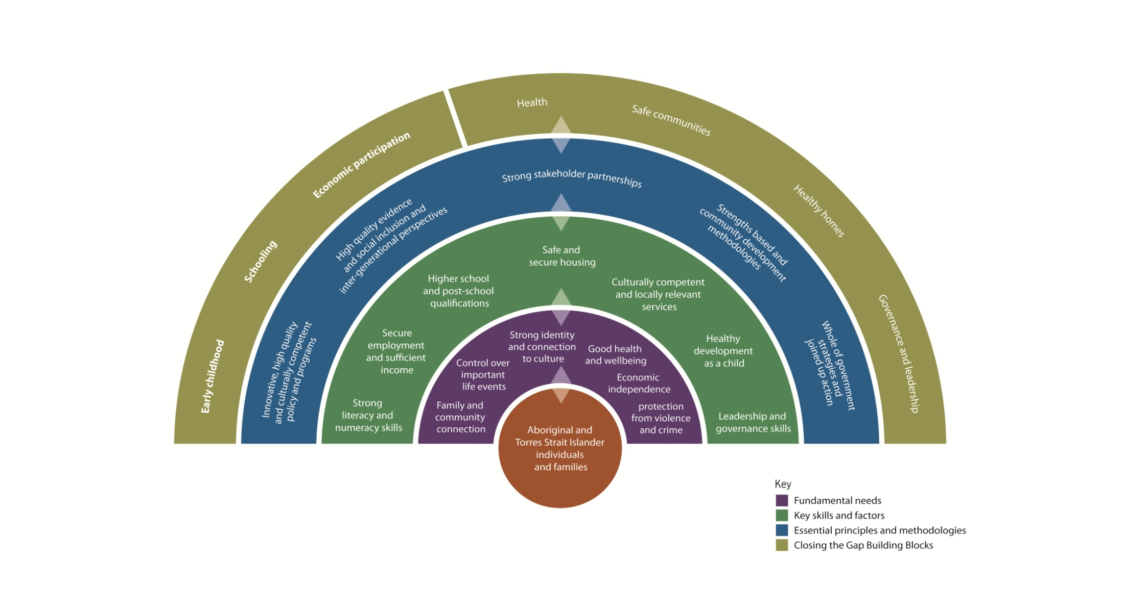
Our work affects a person’s life in many ways
The work we do is interconnected
Notes:
SPEAKING NOTES
This diagram uses a citizen-centric approach to understanding what and how the department needs to work to improve outcomes for Aboriginal and Torres Strait Islander people and their families.
The diagram deliberately puts both individuals and families at the centre to reflect the centrality of family to Indigenous experience and culture.
Working from the outside in:
Commonwealth, State/Territory and local government responsibilities—what we do
Evidence-based methodologies and principles to apply to our work—how we do it
The key skills and factors that an individual must possess to have the opportunity of a healthy and productive personal and family life—the outcomes of what we do and how we do it
The fundamental needs of every person in order to have a healthy and productive personal and family life—our ultimate objective
While DEEWR is directly responsible for only a portion of this picture, we need to understand the whole picture. We need to collaborate with our colleagues in other departments and other governments as well as the private and community sectors to make sure that every Aboriginal and Torres Strait Islander Australian has the opportunity for a healthy and productive life.
Contributing Departments
Department of Education, Employment and Workplace Relations
Department of Families, Housing, Community Services and Indigenous Affairs
Department of Health and Ageing
Department of Human Services
The Attorney-General’s Department
Department of the Prime Minister and Cabinet
The Treasury
Department of Finance and Deregulation
Department of Regional Australia, Regional Development and Local Government
Department of Infrastructure and Transport
Department of Climate Change and Energy Efficiency
Department of Sustainability, Environment, Water, Population and Communities

Slide 15
In Summary...
It has been 3 years since the Closing the Gap targets were set and we have made some inroads
We have delivered a major reform agenda across all targets
Our mainstream and Indigenous-specific programs and initiatives are currently making a difference for Indigenous Australians. However, there is more to be done
We think we are close to on track to achieve the early childhood target
There are some positive signs with the literacy and numeracy and Year 12 attainment targets
The employment outcomes target is our biggest challenge
The greatest challenge will be achieving the last few per cent of the targets
Notes:
SPEAKING NOTES
The Government recognises that ending Indigenous disadvantage caused by decades of under-investment will take time.
The framework is in place and delivery has begun, but there is still a way to go before there is equality for all Australians.
Policies, programs and initiatives must be responsive to the needs of Indigenous Australians, as it should be for all Australians.
It is important to intervene early to make sure that policies, programs and initiatives are achieving the desired results. If not, we need to develop innovative and appropriate solutions.
The Executive Meeting provides strategic direction in DEEWR’s Closing the Gap efforts.
The Closing the Gap Committee ensures that our portfolio responsibilities and business are on track towards achieving the Closing the Gap targets.
Through the RAP Implementation Sub-committee and Cluster Working Groups, the Reconciliation Action Plan sets out our organisational corporate responsibility to ensure we have the internal capacity and capability to address the Closing the Gap agenda.
Regardless of whether you work in the State Network or in an Indigenous-specific, mainstream or corporate area, you have the opportunity to contribute to ending Indigenous disadvantage.
DISCUSSION-STARTER QUESTIONS
How do the Cluster and Group/Branch/Team contribute to the Closing the Gap agenda?
(If the work you do has no direct impact on the Closing the Gap targets, lead a discussion on how it could have an indirect impact, such as by ensuring that the Reconciliation Action Plan is understood and implemented by staff.)
Which Closing the Gap targets are addressed by the Cluster’s and Group’s/Branch’s/Team’s work?
What policies/programs/initiatives/services are the Cluster and Group/Branch/Team responsible for?
In what specific ways do they impact on Indigenous Australians?
In what ways do the Cluster’s/Group’s/Branch’s/Team’s policies, programs or initiatives complement those of other Clusters and other agencies that impact on Indigenous Australians?
What mechanisms are there in place to ensure that this happens?
In what way can the Cluster and Group/Branch/Team strengthen this?
How do the policies, programs or initiatives managed by the Group/Branch/Team benefit Indigenous Australians in remote areas? How do they benefit Indigenous Australians in urban and regional areas?
In what ways do the policies, programs or initiatives managed by the Group/Branch/Team address the needs of young Indigenous Australians?
What mechanisms are there in place to ensure that policies, programs or initiatives address the needs of Indigenous Australians?

Slide 16
