Slide 1
Education in a multi
(-lingual, -cultural –ethnic) society: urge for University to retrieve its universality
नमस्कार
by Daphné L. Romy-Masliah, PH D
Ecole Jean-Piaget (Geneva) ,
Université de Sidi Bel-Abbès (Algeria)
Revue Droit et Culture (Paris)
Notes:
Baroque, comes from Portuguese Barocco, an imperfect peal. Seeks to impress and surprise by emphasizing the freedom of movement, and is associated with the Counter-Reform movement, Martyrs, Vision, Extasis…

Slide 2
Main issues
Geneva, Swiss Canton and Swiss City, approx. 500,000 inhabitants, a Swiss enclave in a surrounding French Territory, a great number of expats using English as everyday work language;
Sidi Bel-Abbès, in a Wilaya, 80 kms away from Oran, once a French military base, now a booming university town, 90 kms from Tlemcen, quite close to Moroccan border, almost 100% Algerian nationals although most/all of them have relatives in France.

Slide 3
Point of view
We will be discussing what Grin calls the internal efficiency process…
However, we will try to see as well what benefits our students are supposed to get both from the trend and from the changes occurring as we speak!
In Geneva: « langues: une solide culture linguistique dans la langue locale (maîtrise orale et écrite) et des compétences essentielles dans une deuxième
langue nationale et dans une autre langue étrangère au moins » (Law 10350 regarding the intercantonal agreement on compulsary school (HarmoS) (C 1 06.0)

Slide 4
Past « foreign » language teaching
In Geneva, these languages weren’t all that foreign and focused a great deal on the intercommunicational process…Loi fédérale sur les langues nationales et la compréhension entre les communautés linguistiques (Loi sur les langues, LLC) art. 1: « b. l’encouragement de la compréhension et des échanges entre les communautés linguistiques » art. 2 « à renforcer le quadrilinguisme comme singularité de la Suisse »; Art. 15 Enseignement(…) (2) Dans le cadre de leurs attributions, la Confédération et les cantons encouragent leplurilinguisme des enseignants et des apprenants.(3) La Confédération et les cantons s’engagent en faveur d’un enseignement des langues étrangères qui donne la priorité à une langue nationale.

Slide 5
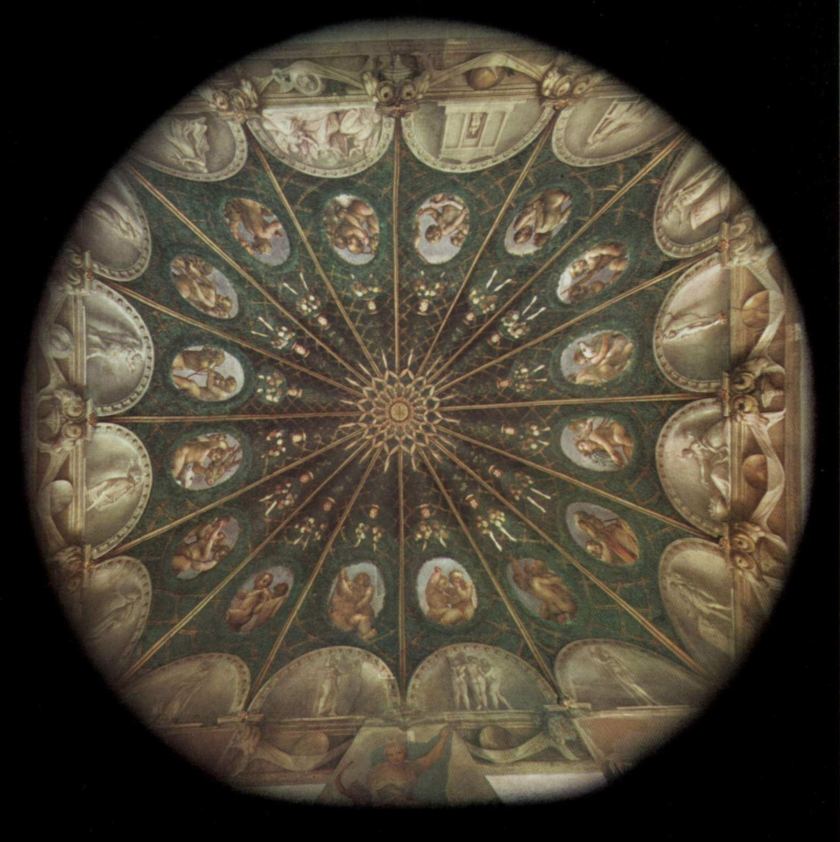
Teaching English,
Switzerland, with its three official languages and its national language
Add the presence of International Organization….
Algeria once a french colony had French as the main Foreign language taught…
Notes:
Le Corrège,
fresque couvent de Parme, 1519

Slide 6
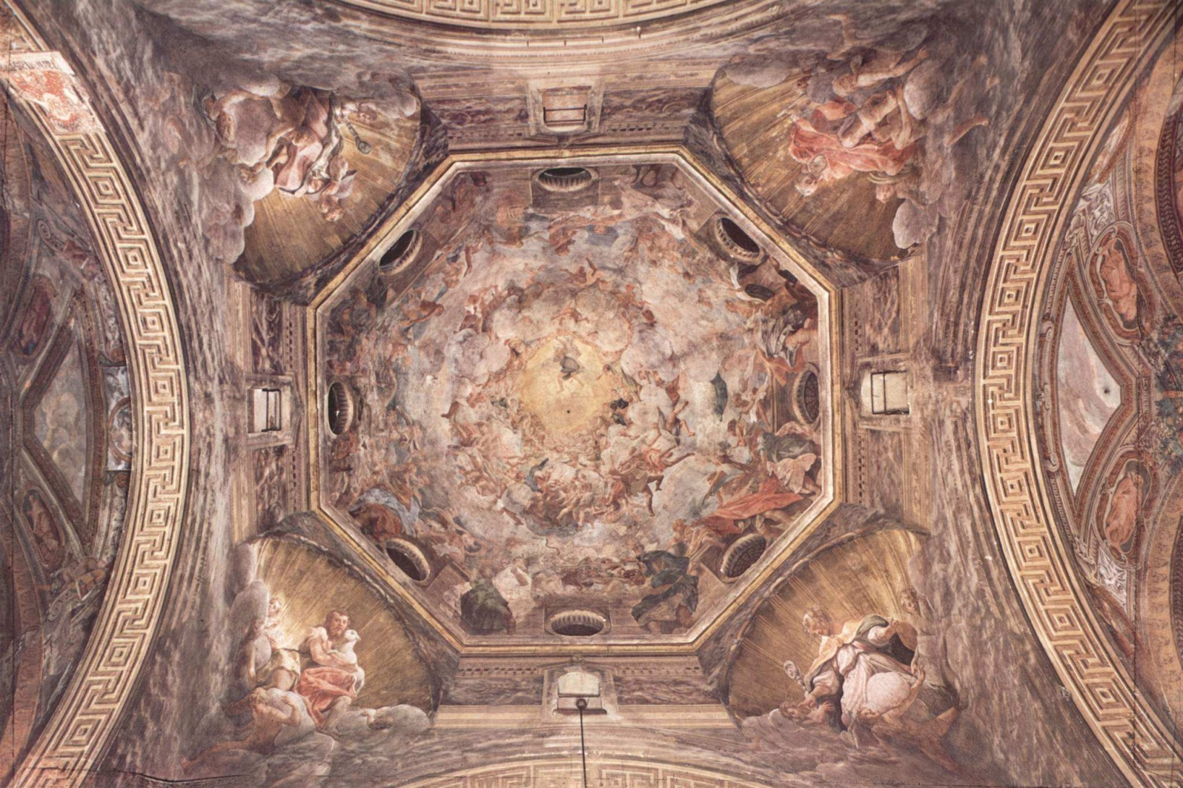
And then came the International Revelation… from 2000 onwards, shift of focus from national to international languages.
Notes:
L’Assomption de la Vierge, coupole de l’église de Parme, 1526-28
2000 was a definite turning point in the Geneva school system. Introduction of English and Spanish as foreign languages in early schooling, European portfolio of languages and the CEFR (COMMON EUROPEAN FRAMEWORK OF REFERENCE
….yet still a very literary approach
targeting a B1 for the final years…
2010 is a new turning point trying to make sense of all this good will…

Slide 7
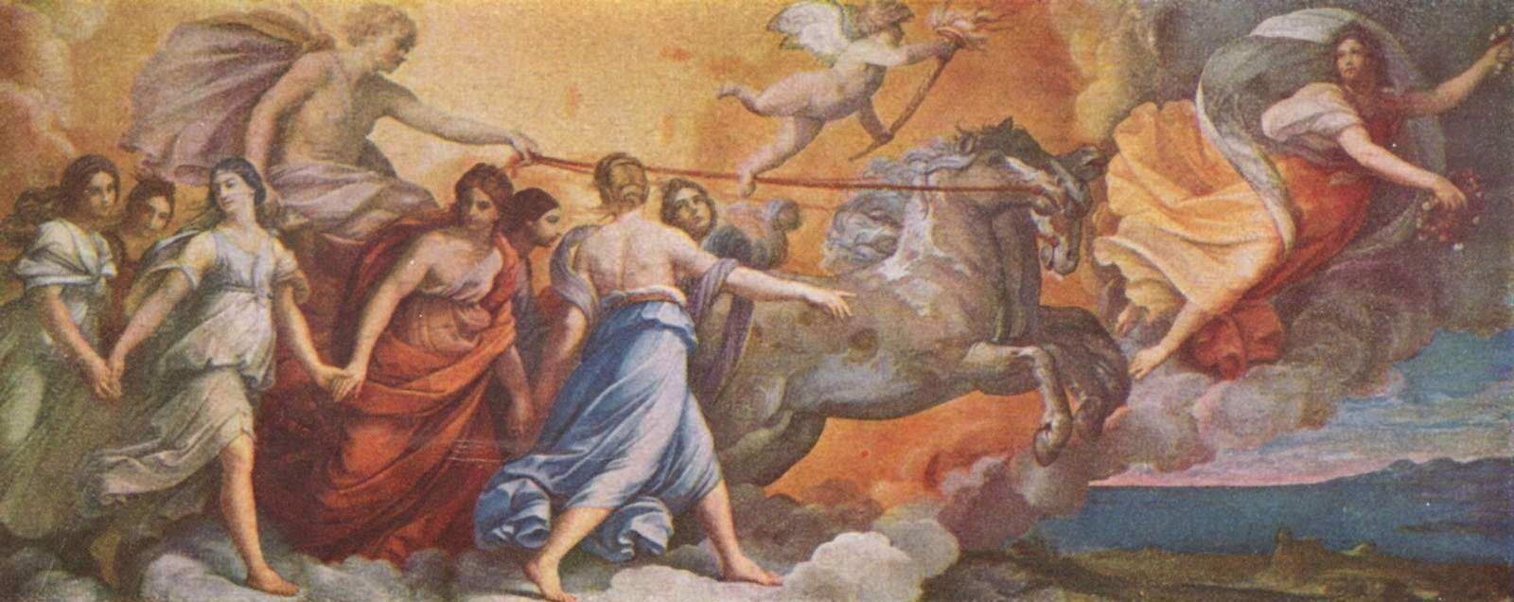
The trend was launched and English the basic educational tool was on its way…
German somehow, despite being by far more useful in Geneva and taught at a very early school stage, is despised and rejected…almost considered a dead language and learnt the way the Irish learn Gaelic (i got great marks and was the best student but still can’t utter a word, Nico Dowling, director of the Atlas English Language School, Dublin). Students reach with difficulty a B1 after at least 7 years of study, a result they reach within 3-4 years in English (3 in Italian)!
Notes:
Guido Reni, Apollon suivant Aurore, 1612-14

Slide 8
It implied
Finding teachers, from 80 to 300 almost overnight…which is how I got involved;-)
Assessing the reality of the need, and now adapting to the Council of Europe’s CEFR
New structure the Refonte des Examens de Langues working group (started in 2008 and will probably take a couple more years to complete its implementation suggestions).
Note: old and new…

Slide 9
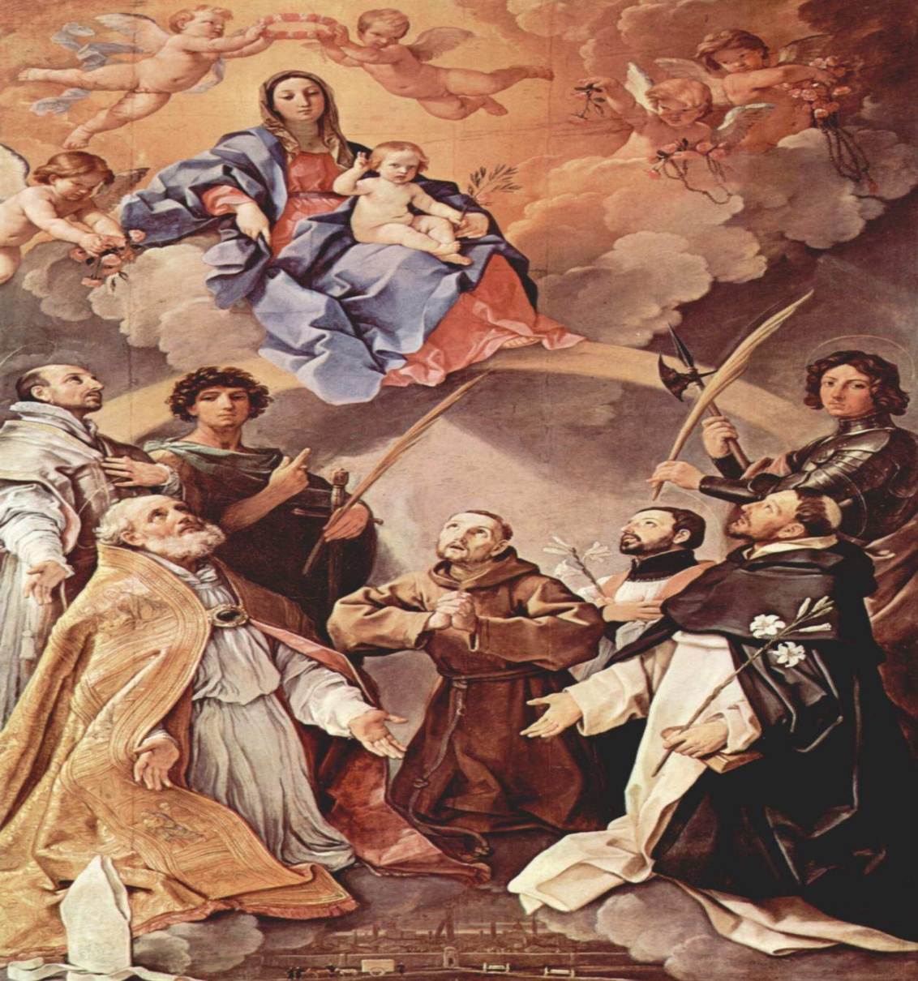
And all this happened while the CEFR was being discussed and implemented, mostly due to Swiss sociolinguists from Neuchâtel…
Notes:
Marie trônant avec les protecteur de Bologne (St Ignace de Loyola, St Petronius, St Proculus de Bologne, St François d’Assise, St Dominique de Caleruega,St Florian de Bologne), 1631-32

Slide 10
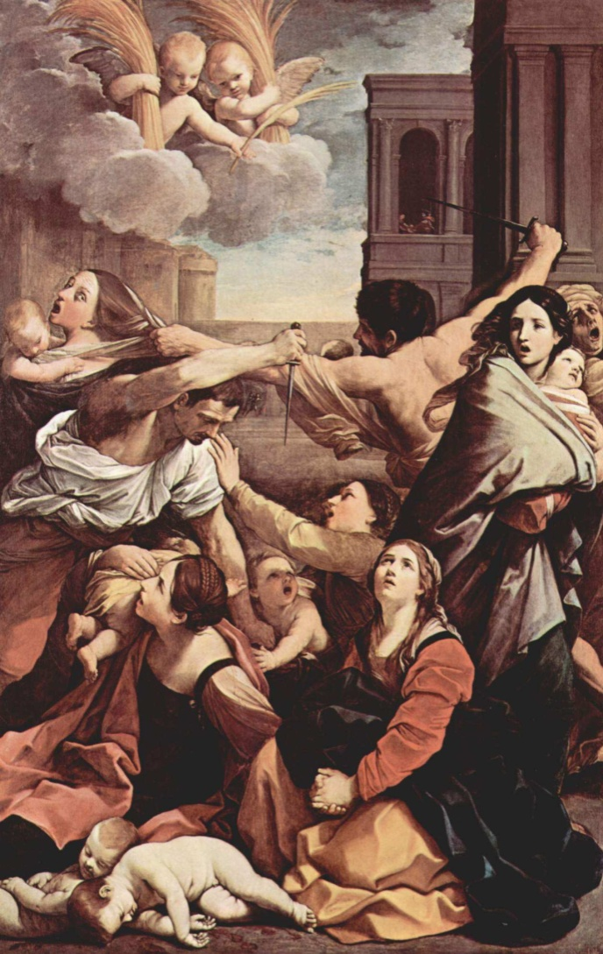
Le massacre des innocents according to some of my distinguished colleagues…
Notes:
1611

Slide 11
The Common European Framework of reference for languages
Learning
Teaching
Assessment …
Self-assessment!
Lots of grids to play with,
Limited but existing cultural reference

Slide 12
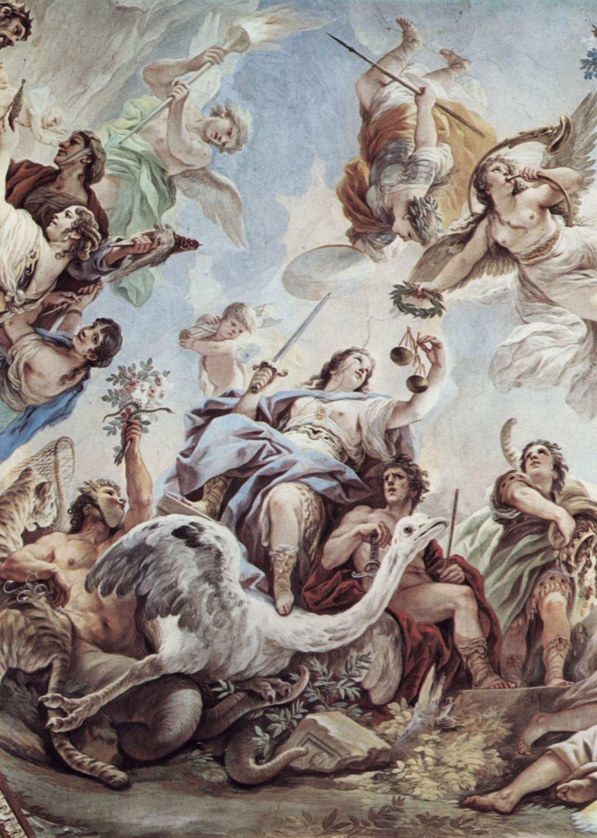
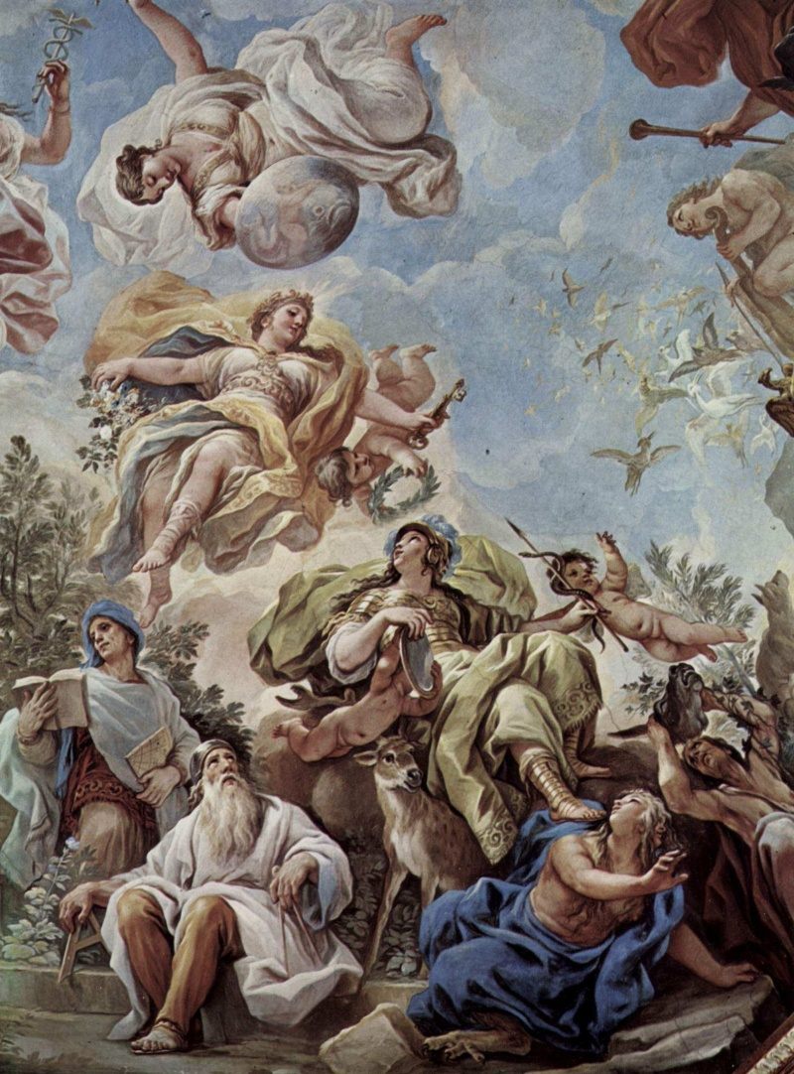
Is it fair? Are we careful?
Notes:
La justice et la prudence

Slide 13
Meanwhile, in Algeria, Sidi Bel-Abbès….
English is the second foreign language taught, both in high school and secondary school while french is taught as early as the third grade (8 years old) reminder, in Switzerland they start at the same age to learn German, the ONLY foreign language introduced in the primary school…
in Universities however, English is a compulsary subject in ALL disciplins and the initial placement test is based on the CEFR with results ranging from A1 to B1 with a few higher exceptions..
On September 16, 2010, during the plenary session of the APN (National Popular Assembly, the Algerian Parliament), the Minister of Higher Education declared that his staff was working on the possibility of introducing English as the medium of communication and instruction in scientific and technological fields, thus…replacing French!!!
French however still keeps a prestige status linked to upward social mobility…

Slide 14
British Council…
Now supervises all Specialised Technology English trainings;
Trains teachers in a cooperation programme with the Algerian Ministry of Education;
… declared in 2009 that it was funding a 55,000$ programme since « English has become the language of global communication and we want to help Algeria improve its integration into the world of commerce, science and education ».

Slide 15
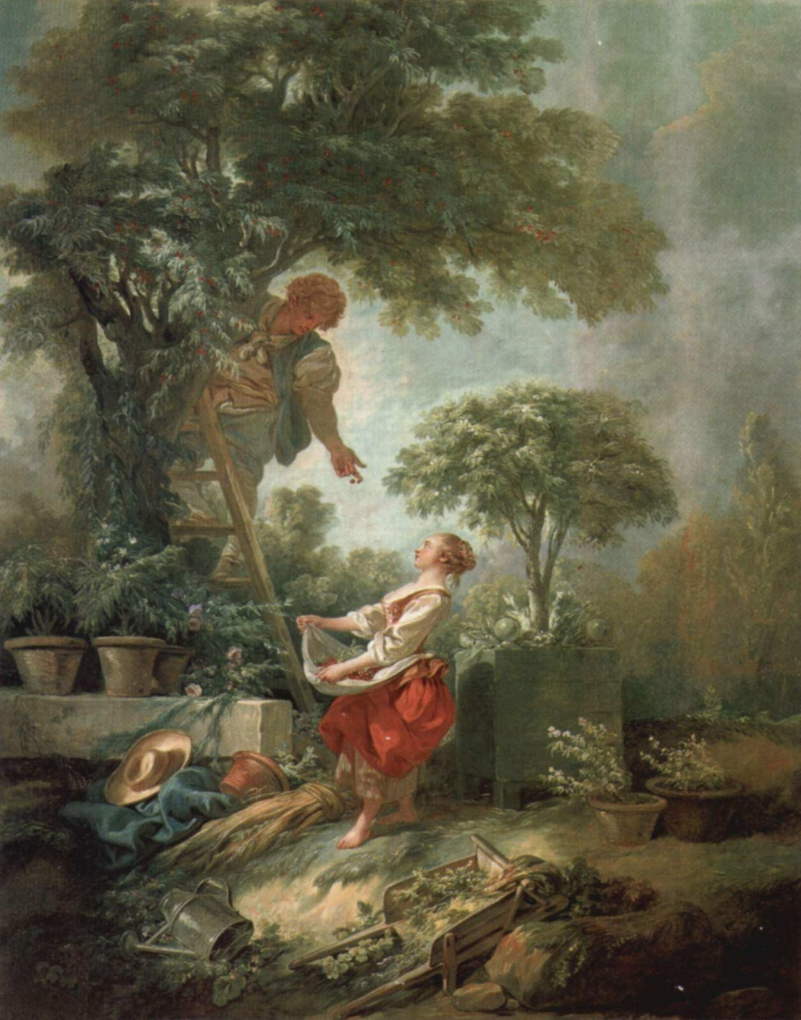
What exactly are we going to harvest?
Notes:
Paysage avec ramasseurs de cerises, 1768

Slide 16
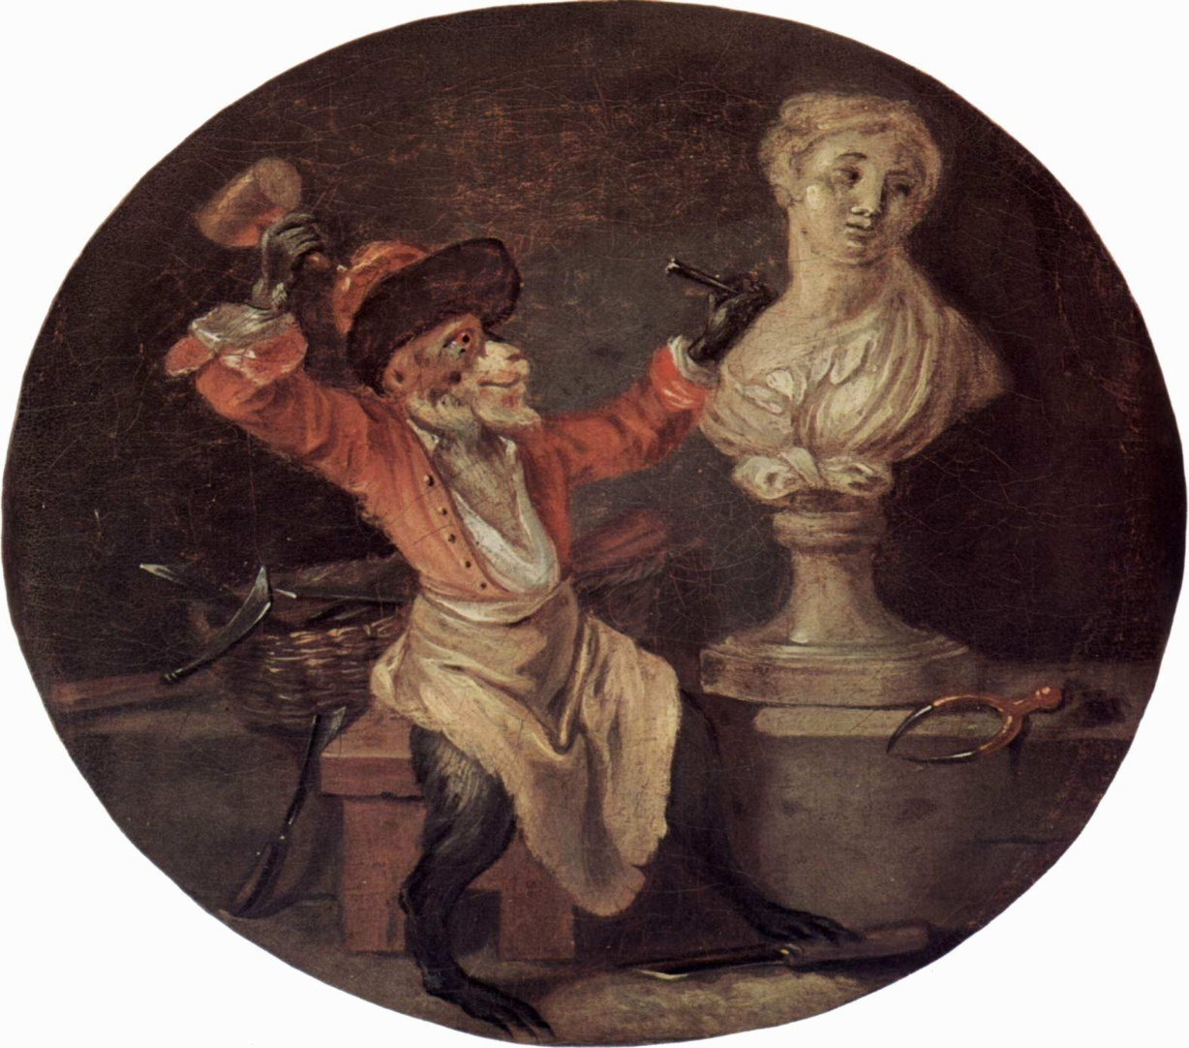
We are considered tearing down the essence of our cultural mission

Slide 17
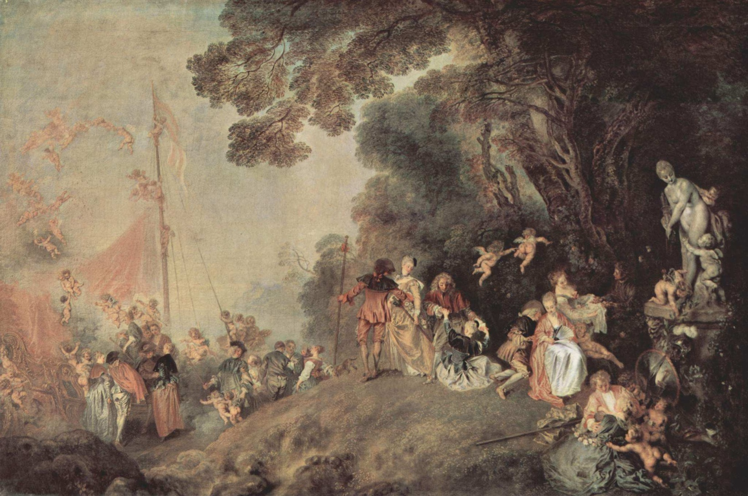
Where is this leading us to?
Notes:
Watteau, Embarquement pour Cythère, 1718

Slide 18
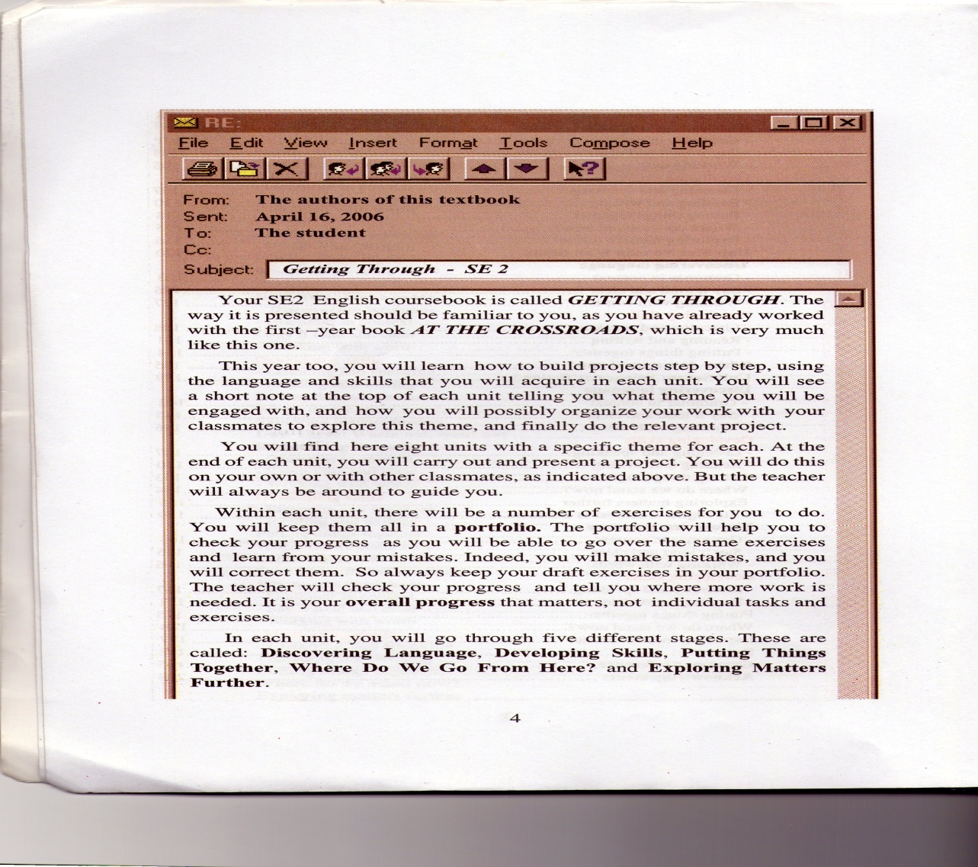
Towards better practices and accurate assessment

Slide 19
To an enhanced international collaboration
Unbiased way to test language skills for all Students and languages;
Contributing to a world dialogue through harmony;
We certainly reached in both instances, Sidi Bel-Abbès and Geneva, a turning point…From Baroque…to… Roccoco, (the ensuing pictural style)!
Académie Sans Frontières, JCall…thinking OUT of the box for an unprecedented era.
Notes:
Décors exubérant et asymétrique
Œuvres chargées de fantaisie (pittoresque, érotisme et exotisme)

Slide 20
Bibliography
Abid-Houcine, S. (2006). Plurilinguisme en Algérie, Sidi Bel Abbès.
Associated Press L'anglais est la langue de l'avenir pour les Suisses, selon deux sondages. AP Wire.
Bourdieu, P. (1981). Le Français chassé des sciences. Paris, CIREEL.
Conseil de l’Europe. (2001). Cadre européen commun de référence pour les langues: apprendre, enseigner, évaluer, Didier. (http://www.coe.int/t/dg4/linguistic/cadre_en.asp)
Didier.Corson, D. (1997). Social Justice in the Work of ESL Teachers. Language Policy: Dominant English, pluralist challenges. W. Eggington and H. Wren. John Benjamins Publishing Company: 149--168.
Ellis, R. (1999). Second Language Acquisition. Oxford, Oxford University Press.
Esling, J., Ed. (1989). Multicultural Education and Policies: ESL in the 1990s. Toronto, OISE Press.
Grin, F. (2007). Pourquoi donc apprendre l'anglais? Le point de vue des élèves. L'Anglais et les Cultures: carrefour ou frontière? D. Romy-Masliah and L. Aronin. Paris, L'Harmattan: 75-95.
Hagège, C. (2012), Contre la Pensée Unique, Paris: Odile Jacob.
Reporter (1989). Say it In English. Newsweek: 22.
Swales, J. (1985). "English as the International language of research." RELC Journal(16.1.): 1-7.

